Slide 1
Exploring the Feasibility of Prompting Daily Task Execution using the NAO Humanoid Robot with Children with Autism Spectrum Disorder
M.A.Sc Defence
by: David Di Xue
Supervised by: Professor Alex Mihailidis

Slide 2
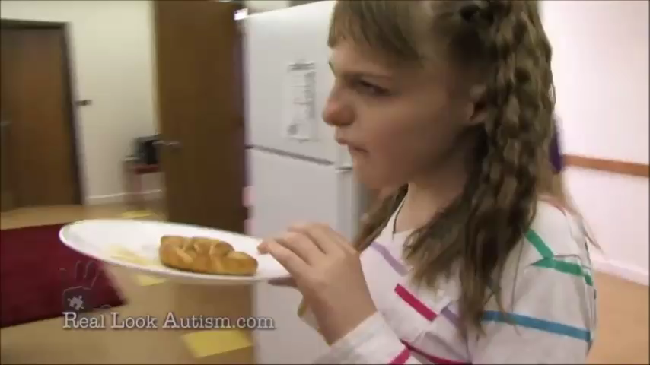

Slide 3
Autism Spectrum Disorder
Impairments in:
Social interactions and communications
Restrictive repetitive behaviors, interests, and activities
Cognitive theories:
Theory of Minds
Weak Central Coherence
Executive Dysfunction

Slide 4
Assistive Technology for ASD
Teaching new skills
Computer based assistive technologies
Augmenting or providing alternatives of Existing Abilities
e.g. Picture Exchange Communication System

Slide 5
Teaching Activities of Daily Living
Computer Based Assistive Technologies
Video Modeling
Applied Behavior Analysis Framework
➔ COACH for Autism

Slide 6
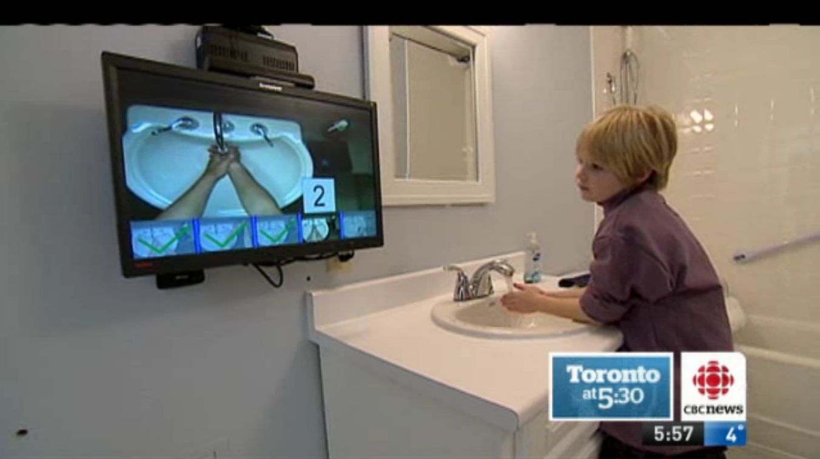

Slide 7
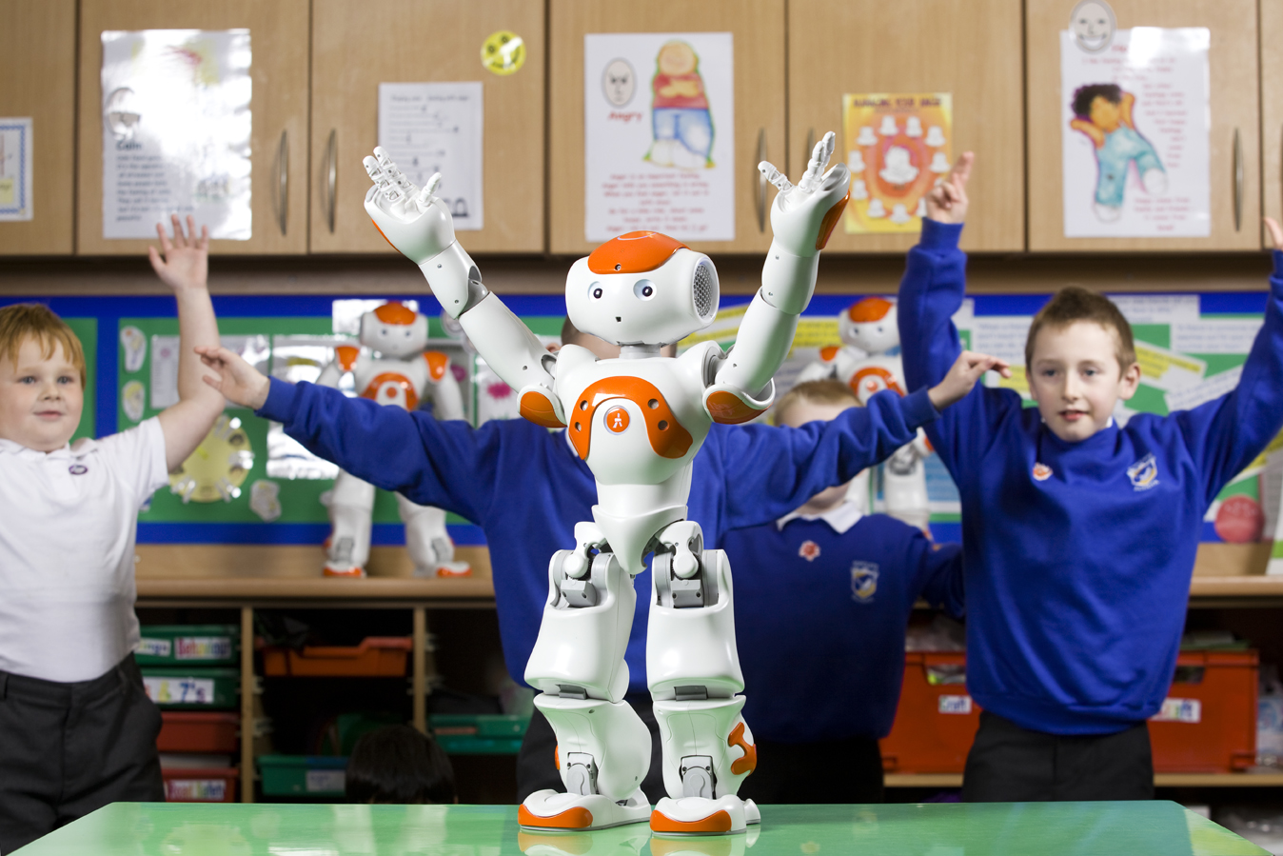
NAO the Humanoid

Slide 8
Central Hypothesis
The humanoid robot, NAO, is able to guide children with ASD through hand-washing independently using verbal and gestural prompts, and high task completion and prompt compliance can be observed.

Slide 9
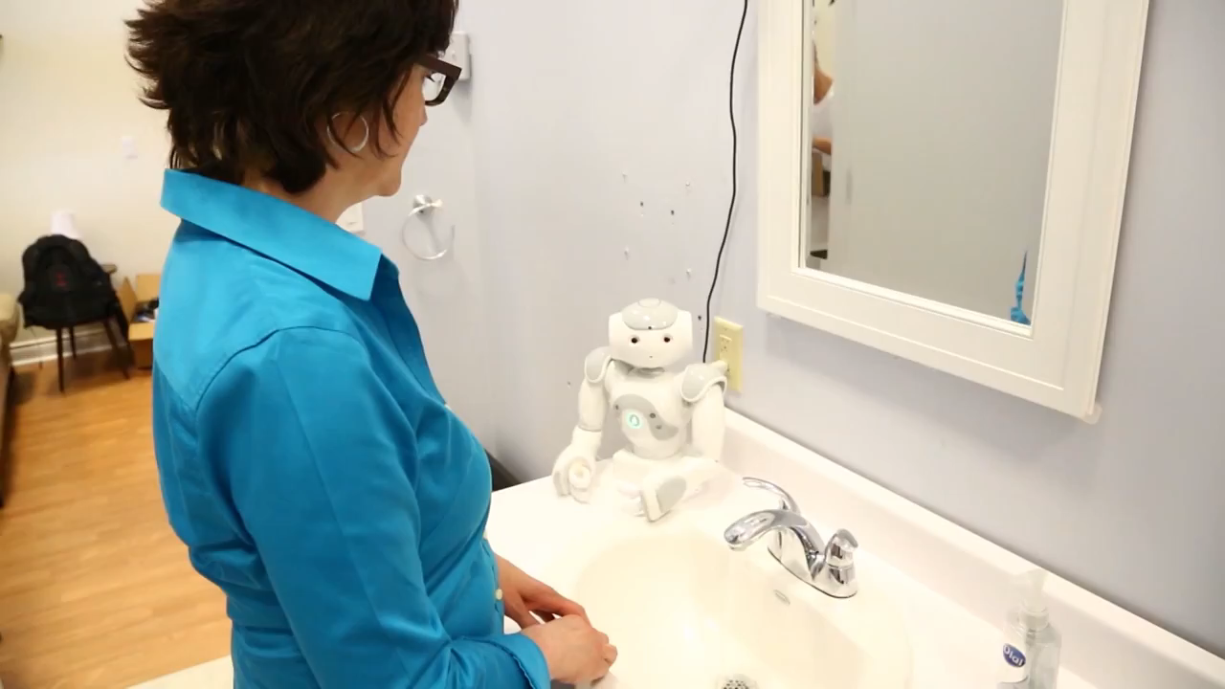

Slide 10
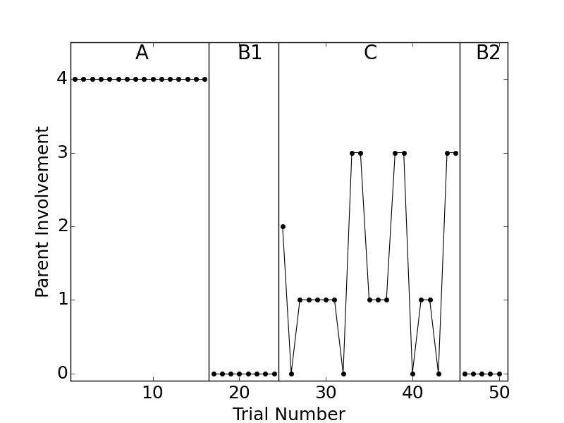
The Wizard of Oz Study
Parent Involvement:
Lvl 0: out of view
Lvl 1: beside child, gesture
Lvl 2: beside child, gesture and verbal
Lvl 3: behind child, physically guide
Lvl 4: beside child with no robot
One participant
Male, 13 years old, born in Philippines
Confirmed clinical diagnosis of ASD
Social Responsiveness Scale score for severe ASD
Can only say one word phrases, but listens to verbal commands well
Needs prompts to stay on task and improve quality of steps
Total: 8 weeks, 50 trials
A-B1-C-B2 design

Slide 11
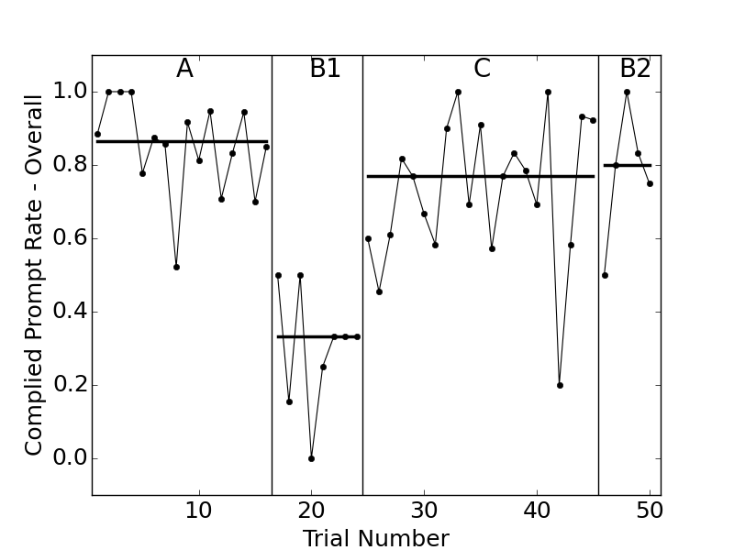
Results – Prompt Compliance
Notes:
Compliance to a prompt, then, is defined as when the child was executing the wrong step or was
idling before prompt, and is executing the right step after the prompt. In addition, when the step is
an extended step (e.g. scrub, rinse, dry), which requires multiple prompts, compliance can also be seen
when the child was executing the correct step both prior to and after the prompt. The \Complied
Prompt Rate" is plotted in Figure 4.7, and the median for Phase A is 87%, for Phase B1 is 33%, for
Phase C is 77%, and for Phase B2 is 80%.
The child is said to ignore the prompts when the child does not change the step before and after
the prompt. Specifically, this happened if the child was executing the wrong step before prompt and
remains executing that same wrong step after the prompt, or when the child was idling before prompt
and remains idling after prompt, or when the child executes the correct non-extended step before and
after the prompt (this usually happened because the robot delivered the prompt too late although the
child knew what to do or when the parent prompted for the child to stop the getting soap step but the
child did not comply). The \Ignored Prompt Rate" is plotted in Figure 4.8, and the median for Phase
A is 10%, for Phase B1 is 33%, for Phase C is 8%, for Phase B2 is 13%.

Slide 12
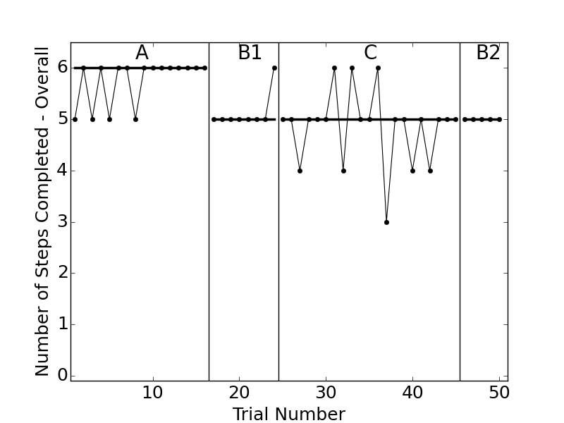
Results – Task Completion
Hand washing steps:
Turn on the water
Wet hands
Get soap
Scrub hands
Rinse hands
Turn off water
Dry hands

Slide 13
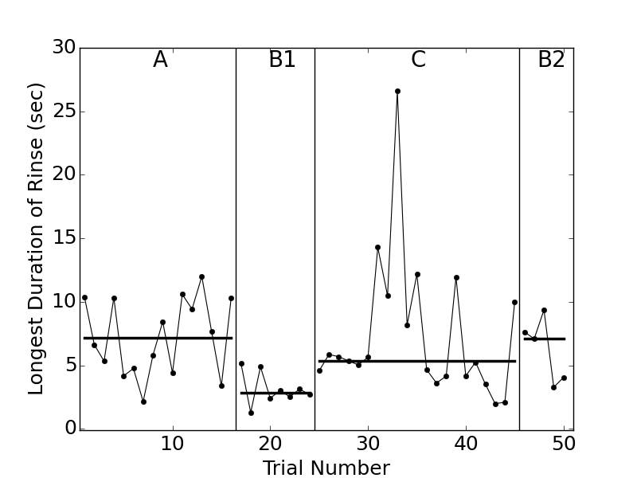
Results – Rinse Durations

Slide 14
Limitations & Confounding Factors
Only one subject, may not generalize
Subject already knows steps of handwashing, only needs supervision on initiation, termination, and quality of steps
Fatigue
Data not collected to saturation
Unfamiliarity
Learning effects
Training phase protocol is not formalized on ABA framework
The robot operator did not have sufficient practice prior to the study
Subject behavior analysis based on non-expert (researcher and parents) opinions
Lack of statistical analysis

Slide 15
Design Recommendations
More visually engaging robot behavior through greater range of motion, faster, and more animated gestures, cartoon sounds and flashing LEDs.
Minimize pauses between robot prompts, use shorter versions for repeating prompts for the extended steps
Need a more severe version of each prompt when child is not complying
Notes:
Generated by comparing child’s responses to parent and robot prompts, noting the opinions of the parents and the researcher during their discussions as well as the parent after study survey.

Slide 16
Thesis Contributions
First study to demonstrate the feasibility of ABA based robot prompting system for children with ASD in guiding them through daily living tasks such as hand-washing
Discovered the importance of a training phase consisting of the parent robot joint prompting in increasing child's compliance to robot prompts
Identified the challenges, possible solutions, and important design recommendations for building and testing the robot prompting system
Created and validated an efficient video coding scheme for analyzing children with ASD's behavior in response to hand-washing prompts

Slide 17
Future Outlook
Is the robot more engaging than the parent? How about versus the video prompts displayed on a LCD screen (old COACH)? How do we measure engagement?
What other activities of daily living can be prompted by our humanoid COACH system?
How to create the artificial intelligence that replaces operator in the Wizard of Oz study?

Slide 18
Thank you!
My family
Alex
Elaine and Azadeh
Tuck, Jennifer, Bing, IATSL lab mates
Jeffrey Little (IBBME Graduate Programs Administrator)

Slide 19
Any questions?

Slide 20
Parent Involvement:
Lvl 0: out of view
Lvl 1: beside child, gesture
Lvl 2: beside child, gesture and verbal
Lvl 3: behind child, physically guide
Lvl 4: beside child with no robot

Slide 21
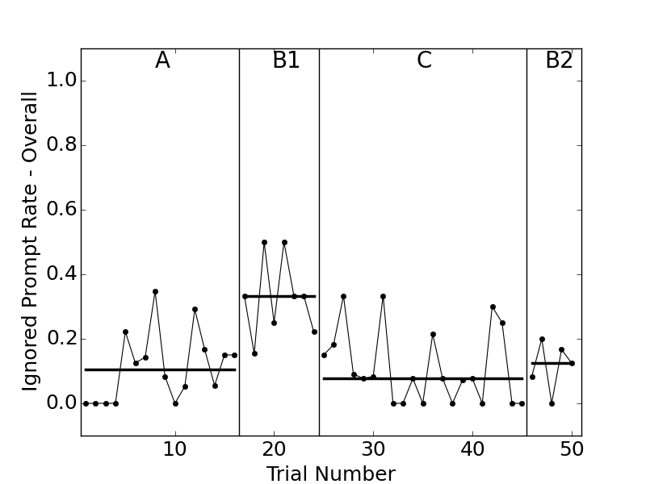
Results - Ignored Prompt Rate

Slide 22
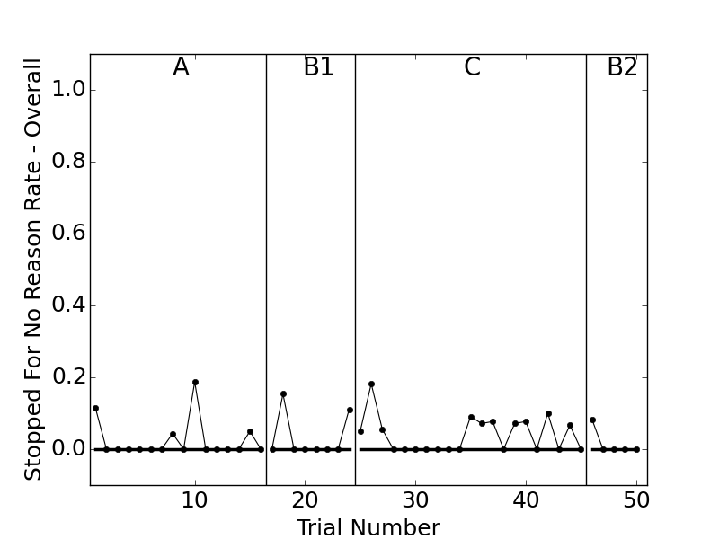
Results - Stopped for No Reasons Rate

Slide 23
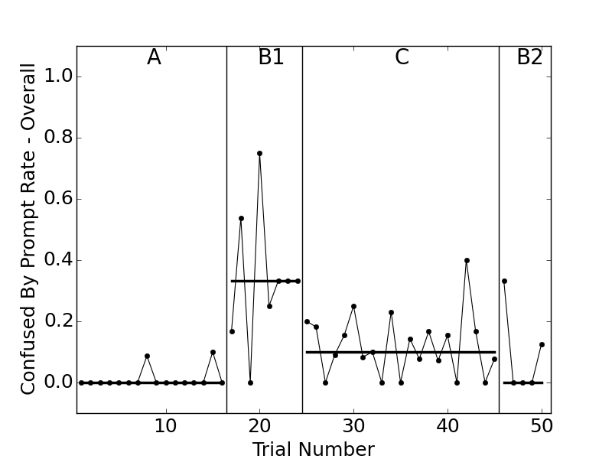
Results - Confused by Prompt Rate

Slide 24
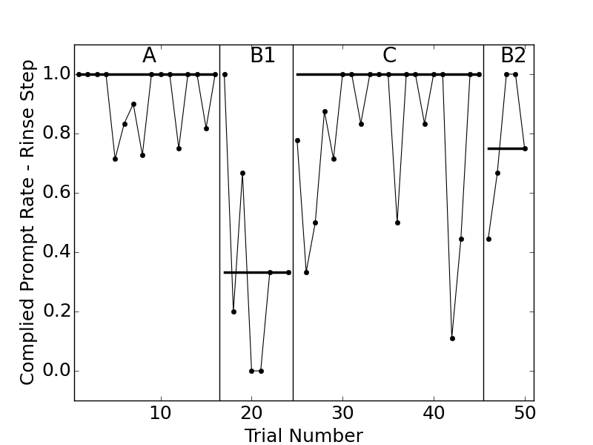
Results – Complied Prompt Rate (Rinse Step)

Slide 25
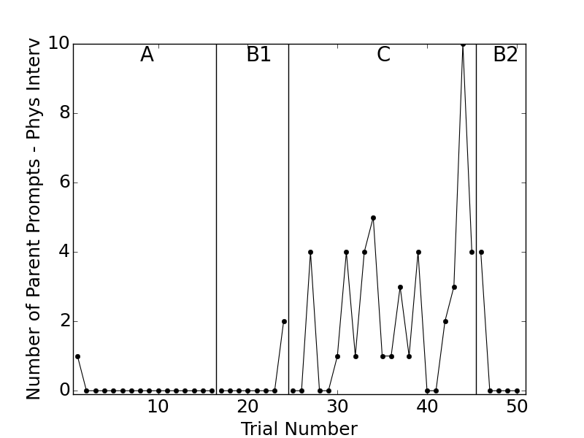
Number of Parent Physical Intervetions

